Slide 1
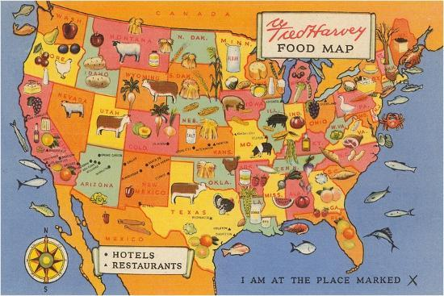
Lodging Proximity and Yelp Restaurants Reviews
Yuechen Chan, Emaleigh Neo, Jorge Rivera-Colón, Kefan Shang, Aupala Bhattacharyya, Dhruv Naik
GB 760 - Group 4
Github link with the data and code: https://github.com/DataTech-Group4/Group-Project-Group-4.git

Slide 2

Agenda
Business Question and Background
Analysis
Discussion and Conclusion

Slide 3
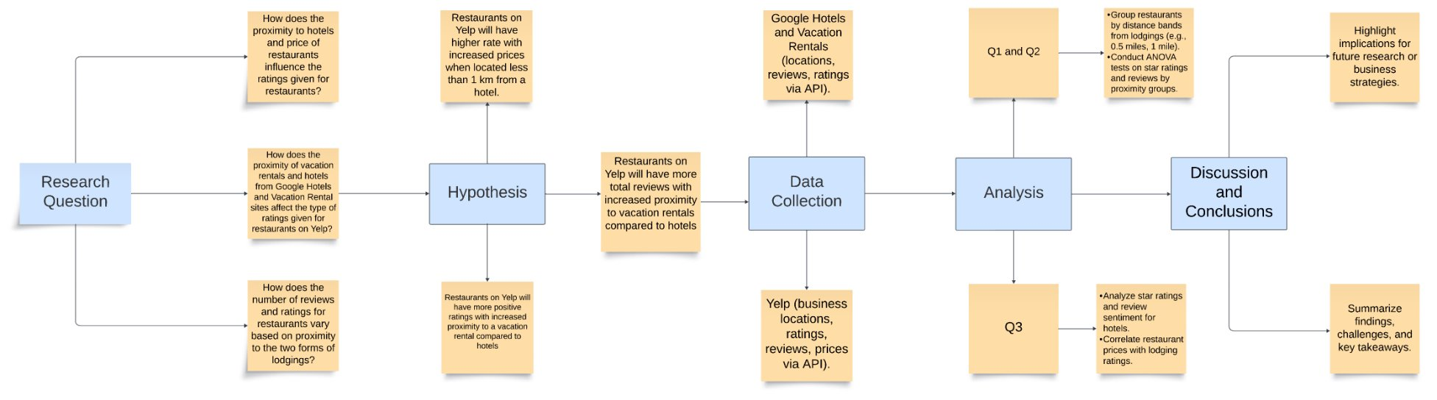
Process Flow Diagram

Slide 4
Question and Background

Slide 5


Business Questions
Q1: How does the proximity of vacation rentals and hotels from Google Hotels and Vacation Rental sites affect the type of ratings given for restaurants on Yelp?
Q2: How does the number of reviews and ratings for restaurants vary based on proximity to the two forms of lodgings?
Q3: How does the proximity to hotels and price of restaurants influence the ratings given for restaurants?

Slide 6
Assumption of data
Ratings are subjective
People’s expectations vary from one restaurant to another.
Proximity to hotels
Customers may be more willing to tolerate walking or driving further for a fine dining experience.
Clustering
High-quality hotels and restaurants might cluster together near business districts.
Notes:
Why are we introducing a new variable and analyzing the relationship between the distance, the price level of restaurants and the rating?
Ratings are subjective: To be specific, you won't expect Wellington Steak from KFC. Also, you will get mad when Michelin chef serves you chicken nuggets.
Proximity to hotels: Customers may be more willing to walk or drive further for fine dining experiences, which could lead to higher ratings for restaurants located farther from hotels.
This is easy to understand. You wouldn’t make a reservation at KFC, and you definitely wouldn’t walk 5 or 10 miles just for a bucket of fried chicken!
The third is clustering. High-quality hotels and restaurants might cluster together near business districts, like magnificent mile in Chicago.

Slide 7

Hypotheses
Restaurants on Yelp will have more positive ratings with increased proximity to a vacation rental compared to hotels
Restaurants on Yelp will have more total reviews with increased proximity to vacation rentals compared to hotels
Restaurants on Yelp will have higher ratings with increased prices when located less than 1 km from a hotel.
Notes:
Prevailing theories behind these hypotheses
We chose to look at these questions and hypotheses due to underlying assumptions about tourists and them wanting to experience the local flavors, but not really knowing where things are and what’s the best out there. We decided to keep fast food restaurants, catering to the younger children and people who need some familiarity or quick convenient food. Additionally, kept proximities to be within walking distance of their hotel or rental, again for convenience of the tourists. Also, restaurants closer to a hotel/rental will have more foot traffic, which can lead to more reviews and ratings given. We originally pulled the data for all 13 states that were available and had at least 3 cities, but narrowed the focus to Florida because of it touristy attractions and cities, like Tampa. In terms of the pricing of restaurants, due to the demographics of hotel users who are typically nonfamilies, smaller groups, and staying for a shorter period, we expect them to spend more and opt for fine dining options.

Slide 8


Data Sources
Yelp Data
Google Hotels and Vacation Rentals Data
Business Location
Business Category (Restaurant)
Reviews
Ratings
Prices (API)
Hotel Location
Rental Location
Reviews
Ratings
Notes:
The primary data is the yelp open source data and the secondary data includes the yelp developer api for prices, google hotels api, and google vacation rentals api

Slide 9
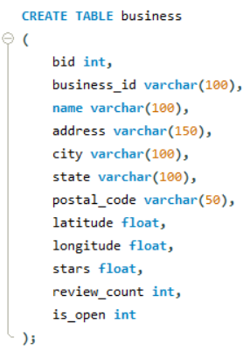
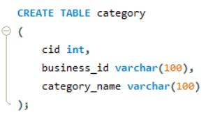
Yelp Data
Business Table:
Yelp Developer API
Restaurant Prices Levels (range from $ to $$$$)
Name
City
State
Address
Postal code
Stars
Review count
Category Table:
Category name
Notes:
Here is the yelp data. From the open source we used the business table and category table to find the restaurants in FL. Then from the yelp developer api, we pulled the restaurant price categories.

Slide 10
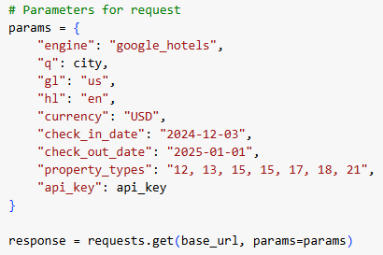
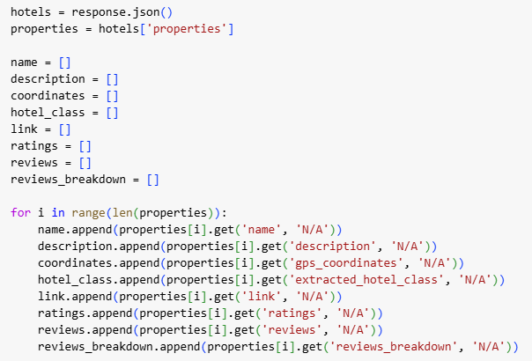
Google Hotels Data
API Scrub
Parameters:
Google Hotels
Looped through different cities for each state
Retrieved:
Name
Description
Coordinates
Hotel Class
Link
Ratings
Reviews
Reviews Breakdown
Notes:
Google Hotels was an api scrub looping through the different cities for each state. We retrieved the name of the hotel, coordinates with latitude and longitude, the rating of the hotel, and the review count of the hotel. The pictures show the parameters we used to retrieve the data and the json lists we used to get the information we wanted.

Slide 11
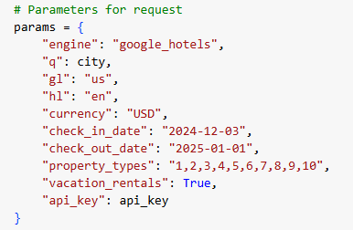
Google Vacation Rentals Data
API Scrub
Parameters:
Google Hotels
Vacation Rentals
Looped through different cities for each state
Retrieved:
Name
Description
Coordinates
Overall Rating
Link
Review count
Notes:
Google Rentals was similar to the Hotels, as it was an api scrub looping through the different cities for each state. We retrieved the name of the rental, coordinates with latitude and longitude, the rating of the rental, and the review count of the rental. The pictures show the parameters we used to retrieve the data. Then the lists you saw for hotels was roughly the same thing we did for the rentals.

Slide 12

Analysis
Notes:
Yuechen kefan

Slide 13
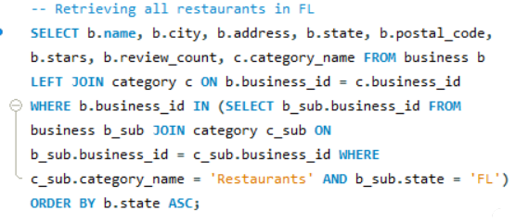
Data Preparation
Combined and Cleaned data
Address Extraction
Combined all the Google Hotel API data retrieved
Combined all Vacation Rental API data retrieved
Retrieved all Yelp restaurant data
Left Joined Category table with Business Table
Addition Subquery to retrieve restaurant categories within specified state
Sorted and aggregated cities with wrong spelling or different formatting
Pulled the Latitude and Longitude from coordinates
Nominatim Geolocator
Retrieved addresses from Latitude and Longitude extracted
Notes:
After data was extracted for the apis, we combined the data into one main spreadsheet for each api, the hotels, rentals, and prices. Then in Excel, we pulled the latitude and longitude out, and switched to python to use a geolocator to find the addresses which included the zipcodes we would be using for the proximity analysis. Then we retrieved the yelp restaurant data using a left join of business table and category table with an addition subquery to retrieve restaurants in FL using sql. After that, we uploaded the yelp restaurant data to python for advanced cleaning, where we sorted and aggregated cities so we would only have one spelling version of each city because there was a lot of variation in how a city was spelled. Additionally, all the data was cleaned where we dropped nulls and any duplicates.

Slide 14
Analysis Q1 & Q2
Distance calculations
Star and Reviews
Merged the data on zipcode
Used geosodic analysis to find the distances between the hotel and restaurant, then rental and restaurant
Merged the updated hotel and rental data together
Restaurants:
Classified by distance
ANOVA test
Average star rank for different distance ranges
Total review count
Count of each star ranking
Analysis | F-statistic | P-value
Average Star Rank | 16.593 | 9.376E-11 **
Total Reviews | 20.256 | 4.356E-13 **
Count per Star Rank | 2.239 | 8.1857E-2 *
** Significant at 0.05 level
* Significant at 0.1 level
Notes:
For Q1 and Q2, we did the distance calculations in python, merging the restaurant data with the rentals and hotel data on their zipcodes. Then used a geosodic analysis to find the distance between a given restaurant and the hotels and rentals. Then merged all the data together and did another clean to ensure there were no nulls or duplicates present.
Then for the star and reviews part of the analysis, we classified restaurants by distance. The ranges were 0-0.8 km, 0.8 to 1.6km, 1.6 to 2.4 km, and 2.4 to 3.2 km. These are discrete, so a given restaurant can’t be part of all the ranges, and this was to keep everything in walking distances. For the people who don’t know kms, its 0 miles to 2 miles total.
The anova tests were done to look at how the star ratings differ across the distance ranges, how the review count differs across distance ranges, and then how the count of the average star ratings differ across ranges of distances.
From the table we can see from the f-stat that the first 2 suggests that each group are very distinct from each other. But the differences are very small between distance groups for the third one. Additionally, the average star ranking was significant, which implies distance has a meaningful impact on the ratings. Total review counts was also significant, so distance does influence the review count of a restaurant. But the count per star ranking was not significant, so this could be random change at 0.5 level. However, at the 0.1 level, it is significant where distance does affect the number of each star rank given, which could have a practical significance to it.

Slide 15
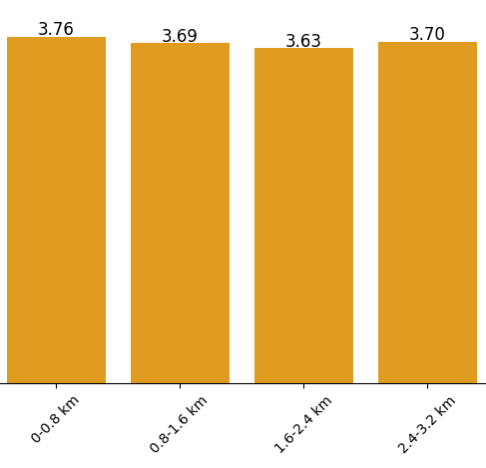
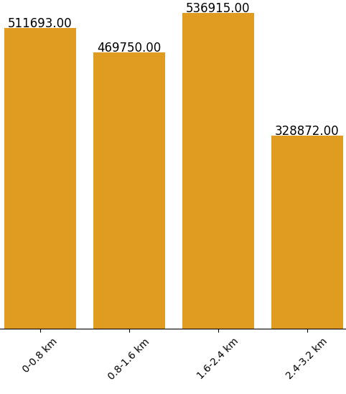
Visual Representation Analysis
Average Star Ratings Across Distance Ranges
Total Review Count across Distances
The chart illustrates the average star ratings for restaurants across different distance ranges (e.g., 0-0.8 km, 0.8-1.6 km, etc.)
This chart displays the total number of reviews across different distance ranges.
Notes:
The first graph shows the average star ratings across the different distance ranges of 0-0.8 km, 0.8 to 1.6km, 1.6 to 2.4 km, and 2.4 to 3.2 km. As we can see, restaurants within half a mile of a lodging had higher average ratings and this decreased with distance. The rating for 1.5 to 2 miles, may be due to consumer bias where the customer had to make a longer commute, dedicating more time and effort to get to the restaurant, so they may perceive that restaurant to be better than it actually is because of the commitment they made to get there. The second graph shows the total review count per distance range. Interestingly, the 1 to 1.5 miles range has the most reviews, but if you were to just consider restaurants within a mile of a lodging then there would be more total reviews from the combination of 0.5 and 1 mile range groups. Additionally, we see about 500K plus reviews when we stay within a mile and a half of the lodging for restaurants.

Slide 16
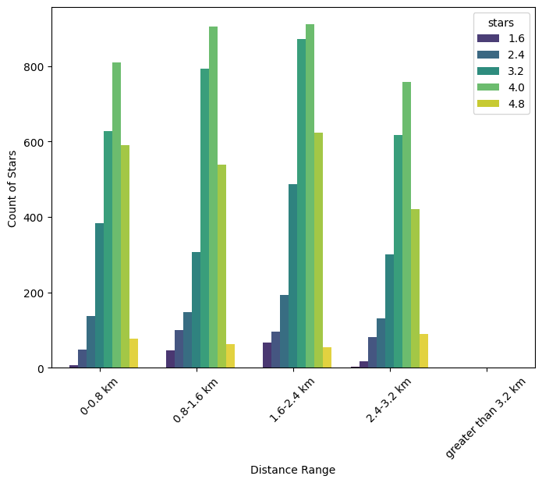
Visual Representation Analysis
Rating Count Across Distance Ranges
The chart shows the distribution of star ratings (ranging from 1.6 to 4.8) across different distance ranges.
Notes:
Third graph is the count of stars across the distance ranges, taking the average of each star rank of 1.6, 2.4, 3.2, 4.0, and 4.8. From this we see a lot of 3 and 4 stars given to restaurants across the distances with the 1 and 1.5 miles having the most. Additionally, the lowest star rating a restaurant could expect from this graph would be a 1.5, but the most common star rating would be from 3 to 5.

Slide 17
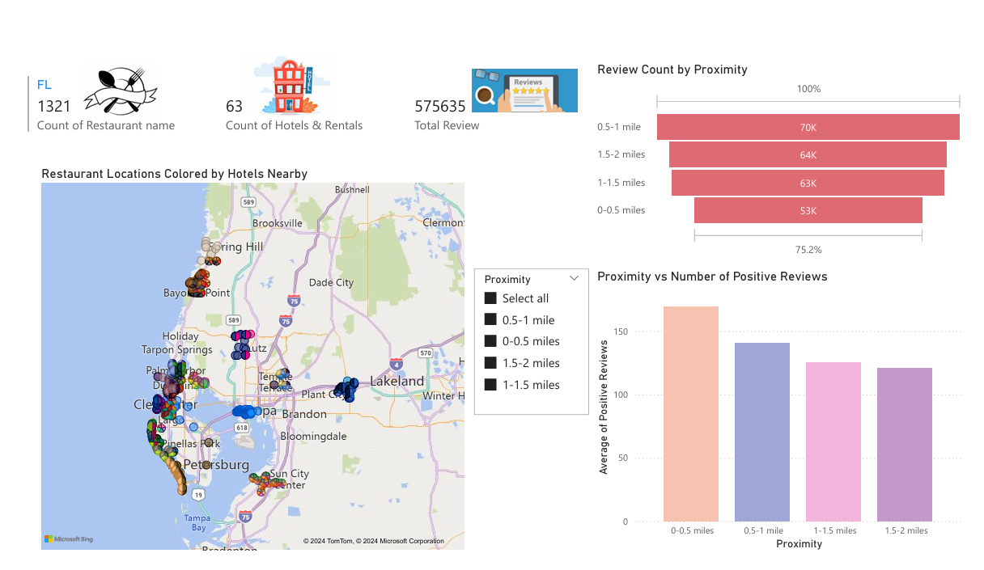
Dashboard Analysis
Notes:
We have analysed the data across 1321 restaurants and total rentals were 63 that included about 575k reviews. The following map shows the distribution of restaurants color coded by their proximity to hotels/rentals. We used the lat and long data to map out the restaurants. The second graph talks about the review count by proximity. We created a calculated called proximity where we created ranges by taking some standard distance numbers. As you can see the review count is highest for 0.5 miles to 1 mile. In the third graph we plotted the..... we considered 1 and 2 stars as negative reviews and 3 and above as positive. It can be clearly inferred from the graph that 0-0.5 miles have the highest positive reviews.

Slide 18
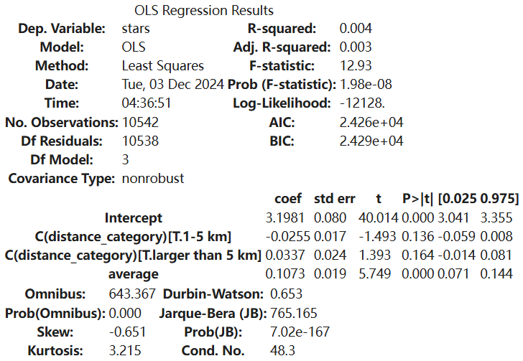
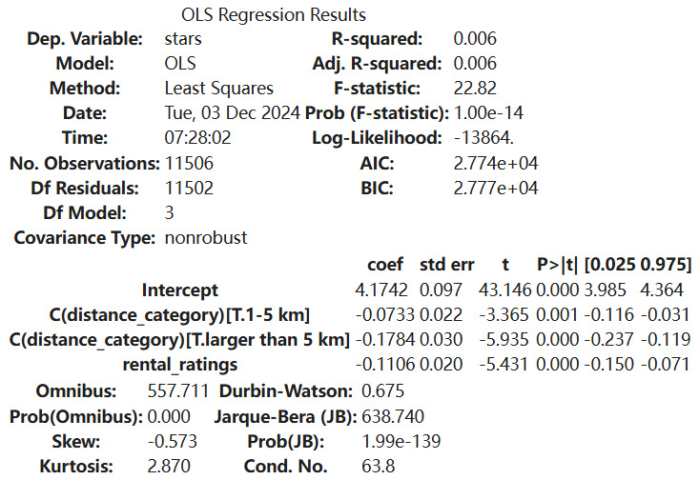
Analysis Q1 & Q2
Effect of Hotel/Rental Rating on Restaurant Rating:
Grouped by distance
Less than 1km
1-5 km
more than 5 km
OLS Regression Model
Notes:
To analyze how the distance between hotels/rentals and restaurants affects restaurant ratings, we applied an OLS regression model. After grouping the data by distance, we observed the following patterns:
For hotel ratings, restaurants located less than 1 km from hotels tend to benefit from higher hotel ratings, with an increase in hotel ratings positively influencing restaurant ratings. However, as the distance increases to 1-5 km and beyond 5 km, the effect of hotel ratings weakens, and in some cases, becomes negative. This suggests that proximity to the hotel plays a crucial role in determining the impact of hotel ratings on restaurant ratings.
In contrast, for rental ratings, we found a consistently negative relationship between rental ratings and restaurant ratings across all distance categories. Notably, as the distance between the restaurant and rental properties increases, the negative impact of rental ratings on restaurant ratings becomes more pronounced. Even restaurants within 1 km of rentals experience a slight decrease in rating as rental ratings increase, with the effect being stronger for restaurants located farther away.
These findings, derived from OLS regression models, highlight that both hotel and rental ratings significantly influence restaurant ratings, but the effects vary depending on the distance between the restaurant and the hotel or rental property.

Slide 19
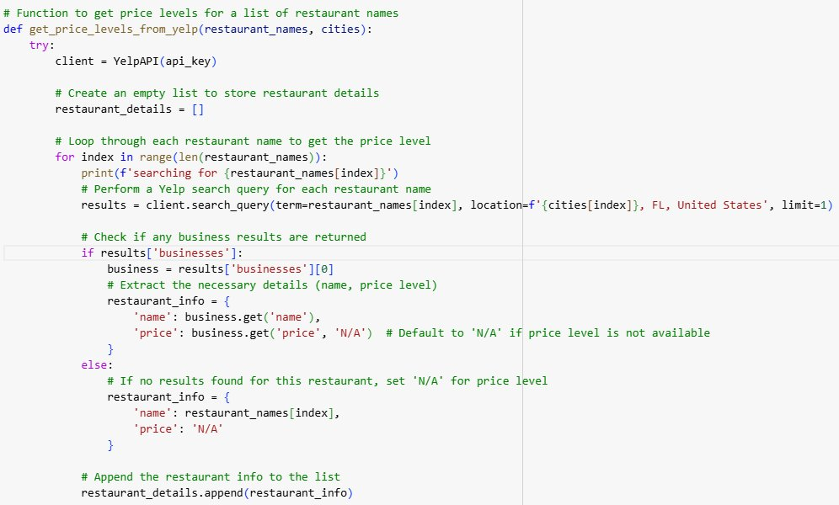
Analysis Q3
API Extraction
Function and loop of restaurants to get price categories
Loop through different cities
Notes:
For this part I design a for loop function to automatically extract the price level using Yelp API. However, each free API can only extract 300 data. Thus we set the loop to 300 data each run and we switch to another API.

Slide 20
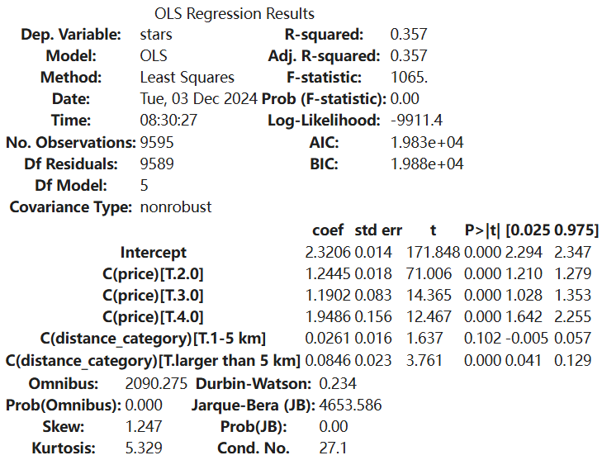
Analysis Q3: Hotel OLS Regression Model
Notes:
For the hotel model, our R-square model fits from 0.4% to 35.7%, which means that 35.7% of the variation in restaurant ratings (stars) is explained by the model's independent variables.
F-statistic:
We have a quite big F-statistic with a p-value < 0.05, it indicates that the model is statistically significant, and at least one of the predictors, the price or distance category, has a significant effect on the restaurant ratings.
We can also find that the base expectation of the restaurant is 2.32, and there is a positive influence on the price and distance towards the restaurant rating. We believe this is because people tend to be more tolerant of the distance they need to walk or drive when it comes to fine dining.
The coefficient columns represent the relationship between ratings, price and distance.
For Price Level 2 ($$), Ratings are 1.2445 units higher than price level 1 ($), and the result is significant.
Price Level 3 ($$$): Ratings are 1.1902 units higher than price level 1. Significant result.
Price Level 4 ($$$$): Ratings are 1.9486 units higher than price level 1. Significant result.
For the 1-5 km category: Ratings are 0.0261 units higher than <1 km, but the result is insignificant.
More than 5 km from hotels: Ratings are 0.0846 units higher than <1 km. Significant result.

Slide 21
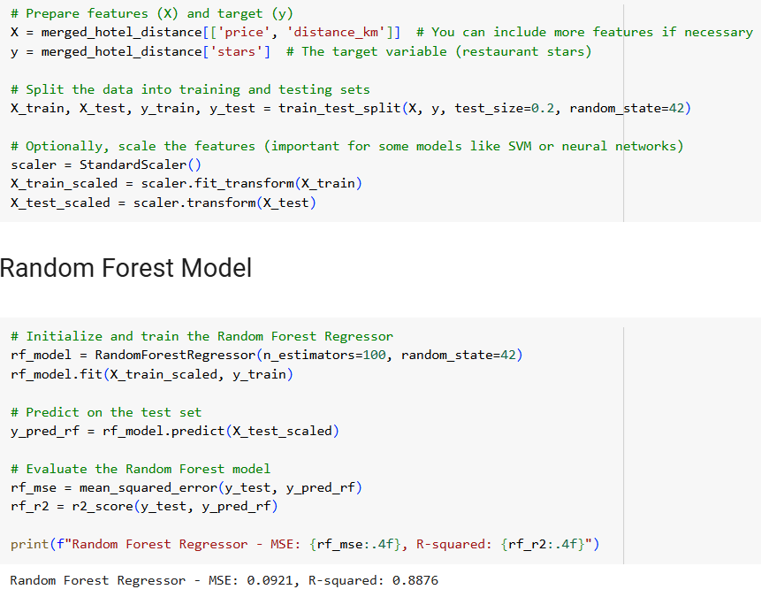
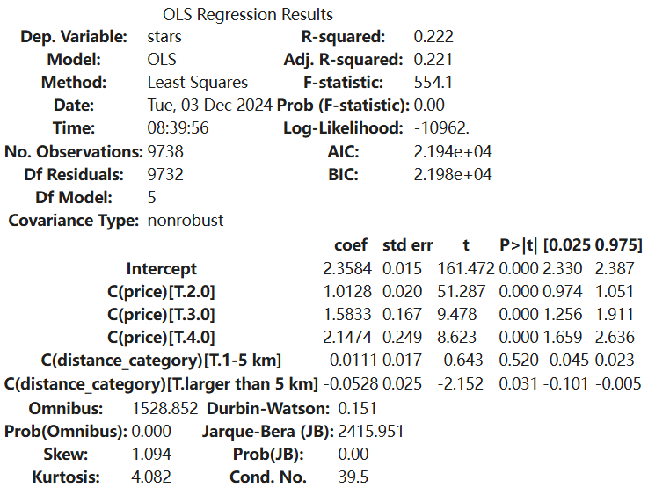
Analysis Q3: Rental OLS Regression Model
Notes:
For the hotel model, our R-square model fits from 0.6% to 22.2%, which means that 22.2% of the variation in restaurant ratings (stars) is explained by the model's independent variables.
F-statistic:
We still have a quite big F-statistic with a p-value < 0.05, it indicates that the model is statistically significant, and the predictors has a significant effect on the restaurant ratings.
Since the analysis part is also OLS regression, we can find that the base expectation of the restaurant is 2.32, and there is a positive influence on the price, but the negative correlation on the distance towards the restaurant rating.
And just to mention we also did the Random Forest Model and get a 88% fitness which will be suitable for the future analysis.
---
For the rental model, R-square means that 22.2% of the variation in restaurant ratings (stars) is explained by the model's independent variables.
The F-statistic is 554.1, which is quite high, indicating that the model is significant overall.
Price level 2 ($$): Increases ratings by 1.01 stars compared to price level 1 ($).
Price level 3 ($$$): Increases ratings by 1.58 stars compared to price level 1 ($).
Price level 4 ($$$$): Increases ratings by 2.14 stars compared to price level 1 ($).
For the 1-5 km category, there is a small negative effect , but it is not statistically significant (p = 0.520).
For Larger than 5 km, there is a small but significant negative effect , indicating that restaurants farther from hotels tend to receive slightly lower ratings compared to those within 1 km.

Slide 22
Discussion and Conclusions
Notes:
Kefan, yuechen

Slide 23
Key Takeaways
Distance effects the star ratings given to restaurants
Restaurants closer to a hotel or rental, tend to get higher ratings
Optimal walking distance appears to be under 0.5 miles and 1.5 to 2 miles
Hypothesis was supported
Distance also influences total review counts for restaurants
Restaurants that were more than 30 minutes away, have fewer reviews given.
Optimal walking distance seems to be under 0.5 miles and 1 to 1.5 miles
Hypothesis not supported
More expensive restaurants received higher ratings
But distance does not seem to matter
Hypothesis not fully supported
Notes:
Kefan, Yuechen
The 1.5 to 2 miles requires more effort and time – could be due to the commitment to get there and wanting to justify the distance by saying the food tastes good (Review bias)
One major takeaway we took from this is that geolocational data is very hard to work with and come with a lot of challenges like having to decide between getting results in a shorter time span versus getting very accurate and precise results that take forever to run. Or wanting to use multiple states since they all have something different to offer, but again because the distance calculations take a couple of hours to run, having to choose between quicker results or more results that takes more than a day to retrieve.

Slide 24
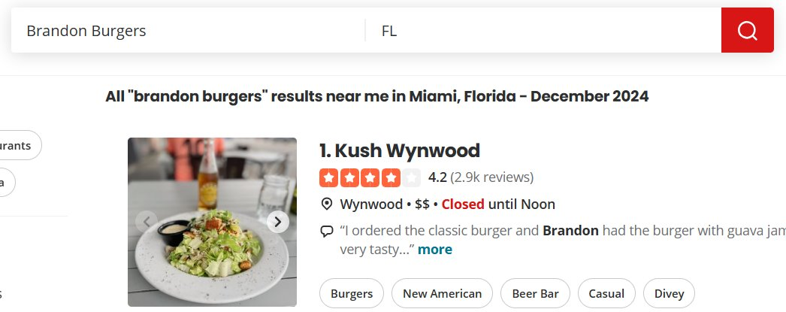
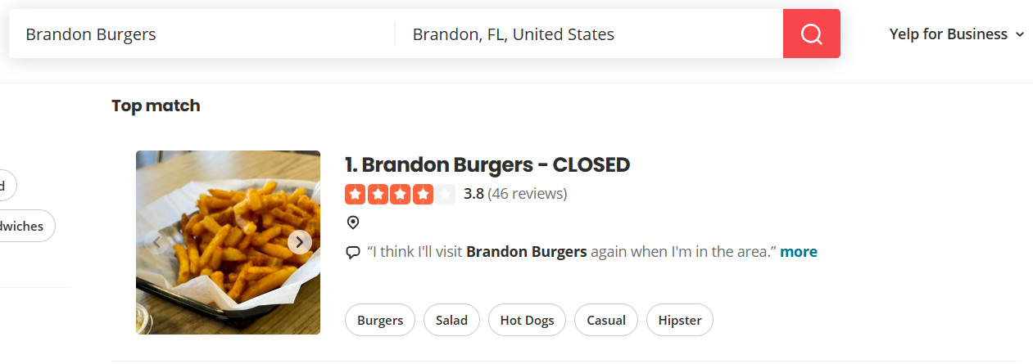
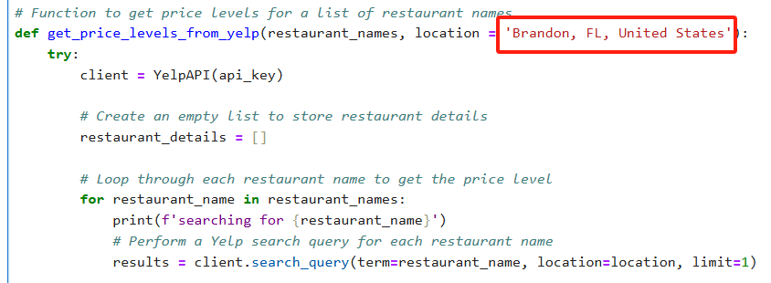
Challenges
Data Cleaning
Google Hotels site and Google Vacation Rentals sites are set up differently
Vacation rentals doesn’t allow for a review or ratings breakdown
Review bias in ratings and reviews given for restaurants
Computer limitations
Sponsored results vs. actual results, search parameters
Notes:
Some challenges included the data cleaning, the structure of the google apis, the review biases for the ratings and reviews given for the restaurants. Also, computer limitations, especially with extracting the apis and finding the proximities using latitude and longitude, then merging the data on the zipcode instead of latitude and longitude. Additionally with the computer limitations, not being able to use a really rich dataset that included more than one state and the few cities in that state. Then the being given the sponsored results vs. the actual results when you enter a search parameter.
And there is one little challenge that, when using Yelp's website as a regular user, you can search for restaurants or businesses by entering a keyword and location. For example, if you search for "Brandon Burgers" and specify the location as "FL", the first result is Kush Wynwood, which is not related to "Brandon Burgers." This result is consistent with what is returned by the Yelp API.
However, if you want to get relevant results for Brandon Burgers, the correct search format on Yelp’s website requires you to input the full location as "Brandon, FL, United States". This ensures that the search results are specific to Brandon, Florida, and will return restaurants related to that location.

Slide 25
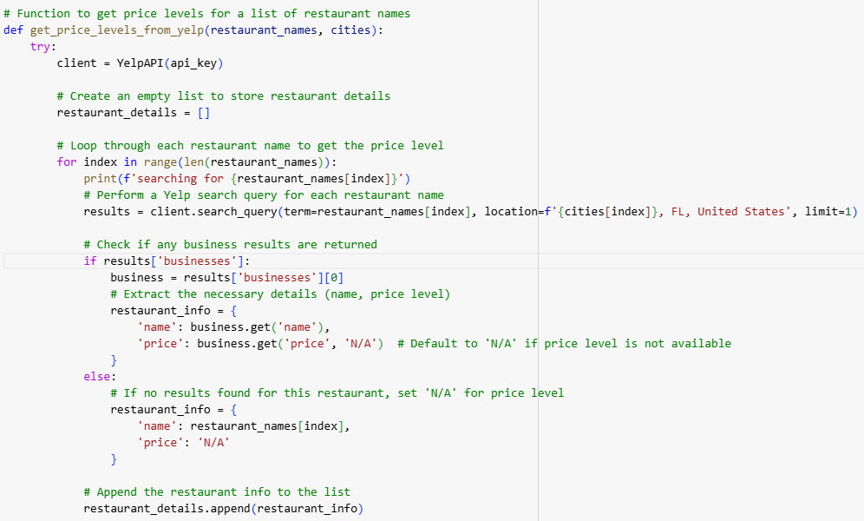
When we insert restaurant name 'Brandon Burgers':
Restaurant name returns Kush Wynwood
=> Irrelevant to Brandon Burgers, but matches our outcome from API key!
On Yelp, if you want to search for Brandon Burgers, you must fill in:
Notes:
And there is one little challenge, also one funny fact that, when using Yelp's website as a regular user, you can search for restaurants or businesses by entering a keyword and location. For example, if you search for "Brandon Burgers" and specify the location as "FL", the first result is Kush Wynwood, which is not related to "Brandon Burgers." This result is consistent with what is returned by the Yelp API.
However, if you want to get relevant results for Brandon Burgers, the correct search format on Yelp’s website requires you to input the full location as "Brandon, FL, United States". This ensures that the search results are specific to Brandon, Florida, and will return restaurants related to that location.

Slide 26


Future Research
Examining the sentiments of Hotel reviews and incorporating it into our business questions. As well as text analysis of the reviews for restaurants.
New business question: How do hotel ratings and reviews impact restaurant pricing?
Examining the correlations between distance ranges and the star ratings, as well as review counts
How the categories a restaurant is classified under in Yelp affects the reviews and ratings?
Temporal trends in the lodgings and the restaurants.
Notes:
Jorge

Slide 27
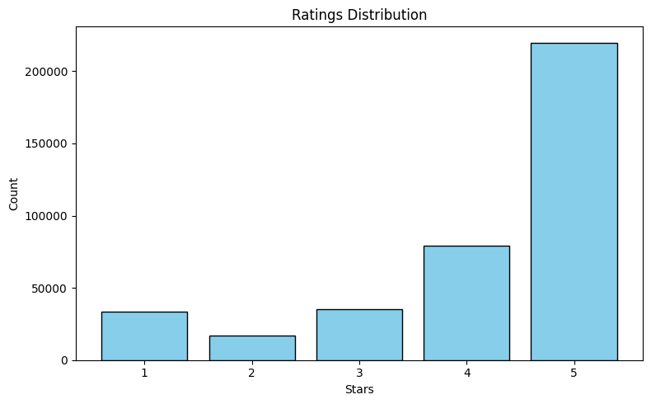
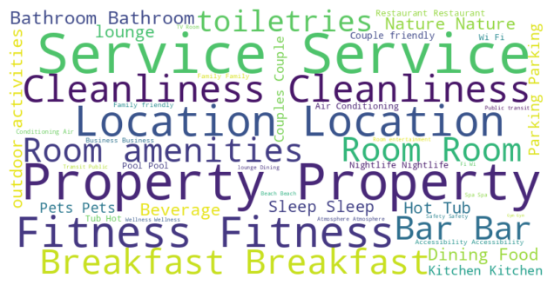
Sentiment Analysis - Florida Hotels
We generated a word cloud to provide a visual summary of the most commonly mentioned keywords in the reviews.
The graph shows the distribution of ratings, with a bar chart visualizing the total number of reviews for each star rating.

Slide 28
Any Questions?
Notes:
Jorge

